Slide 1
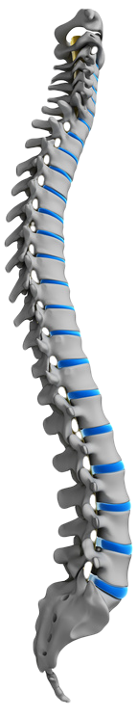
Obesity and Spinal Pain

Slide 2
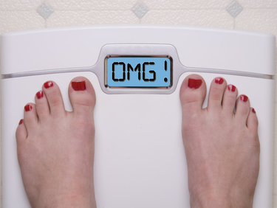
Introduction
According to the American Heart Association, 60-70% of Americans are overweight or obese.
Most think of obesity contributing to heart disease, high blood pressure, strokes, diabetes, and colon cancer.
But it also puts a strain on your low back discs, joints and muscles/tendons/ligaments.

Slide 3
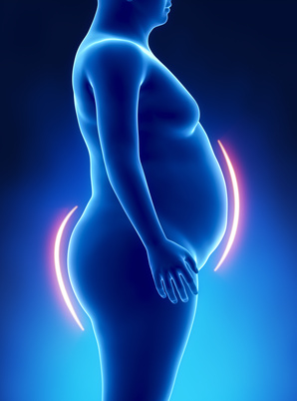
Pelvic Changes
A large abdomen pulls the body forward and down.
In order to compensate, people arch their back.
Creates tremendous stress on the low back joints → earlier painful arthritis.
These changes also lead to poor posture of the neck/shoulders.

Slide 4
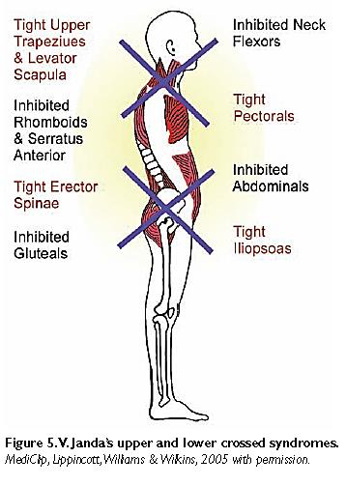
Tight Muscles
A sedentary lifestyle with hours of sitting each day creates a number of tight and weak muscles.
Below are four that lead to low back pain.
Tight hip flexors and low back muscles.
Stretched and weak gluteus maximus and abdominals

Slide 5
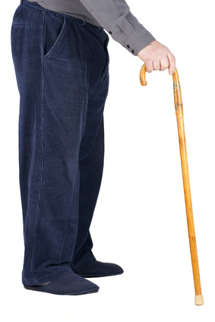
It’s Not Normal Aging
Most obese people will blame their aches and pains on normal aging processes.
As shown before, the excessive weight puts excessive strain on your low back joints/discs/etc.

Slide 6
Good News
The risk of lung cancer decreases every year after you stop smoking cigarettes.
Likewise, you can reverse most muscular changes from obesity by losing weight and performing targeted exercises and regular home stretching.

Slide 7

Correct The Imbalances
First: Get a thorough evaluation by a skilled Physical Therapist.
They will be able to determine which muscles are short/tight and which are elongated/weak.
Next: Get a home exercise and stretching program from your Physical Therapist.
Be consistent with the program.

Slide 8
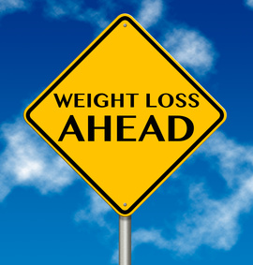
Weight Reduction
Find a Nutritionist to assist you in proper eating habits.
Use a smartphone app to track the number of calories you eat.
Buy a pedometer and walk at least 10,000 steps per day.
Join a gym and weight loss program (Weight Watchers) near your home.
Bottom line: Burn more calories than you put in each day.

Slide 9
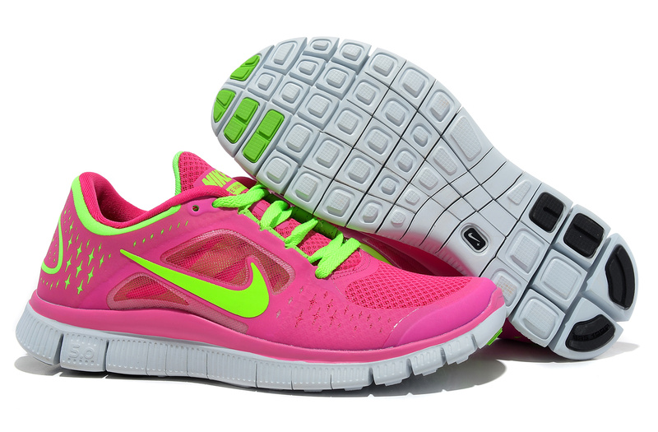
Good Support
Shoes: When starting to exercise, and even during normal every day walking, comfortable, supportive shoes are incredibly important.
Custom-fitted arch supports are sometimes very helpful.
Mattress: Since we spend 5-8 hours every day lying in bed, a mattress that supports your spine and minimizes the need for frequent position changes is important as well.

Slide 10
Treat the Source of the Pain
Before beginning a physical therapy program or starting to exercise at the gym, you may need to treat the pain you currently have.
Bad idea: Covering up the pain with narcotic pain medications.
Better idea: Find the painful structures in your low back or neck and have a more direct treatment with precision, x-ray guided procedures.

Slide 11
For More Information
If you would like more information about Salem Pain & Spine Specialists, please call (503) 967-6771 or contact us online using the “Contact Us” section of our website at www.salempainandspine.org
DISCLAIMER:
This material is presented here for informational and educational purposes only. This information does not constitute medical advice and is not intended to be a substitute for professional medical advice. You should always seek the advice of a physician or other qualified health care provider before beginning any exercise program. If you experience any pain or difficulty with any exercises, stop and consult your health care provider. SPSS MAKES NO WARRANTIES, EXPRESSED OR IMPLIED, THAT THE INFORMATION CONTAINED IN THESE MATERIALS WILL MEET YOUR NEEDS.

